Slide 1
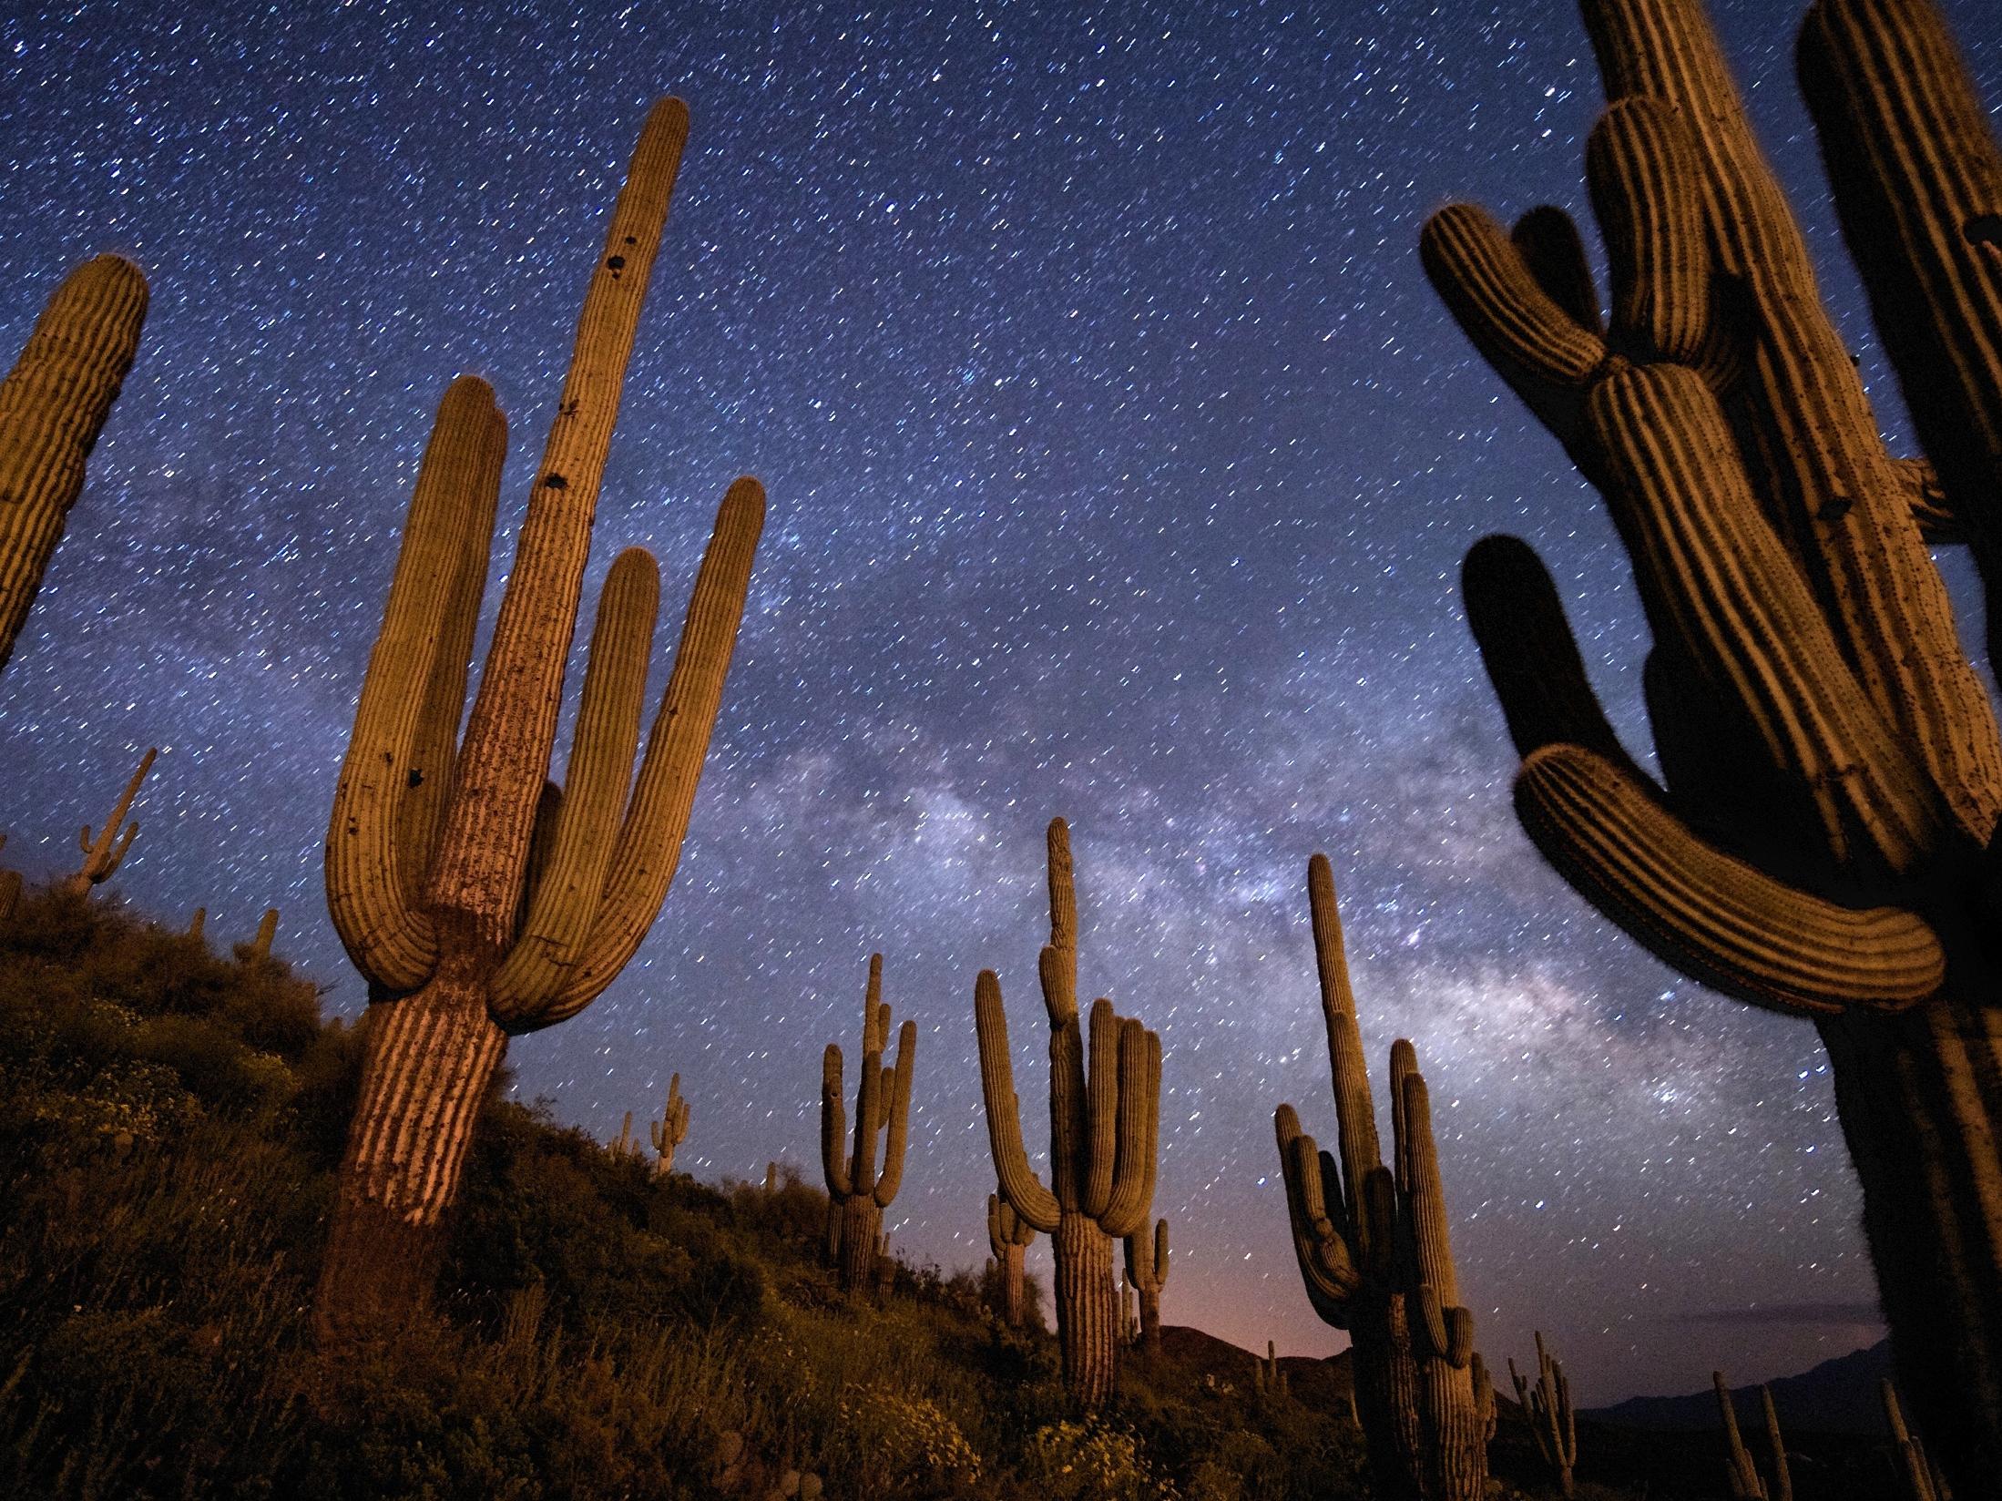


LOSING THE DARK
AT THE SPEED OF LIGHT
An Introduction to Light Pollution
and Energy Conservation for
the Dark Skies Outreach to
Sub-Saharan Africa Program
CONNIE WALKER
NATIONAL OPTICAL ASTRONOMY OBSERVATORY
Photo by Jim Richardson

Slide 2
Photos of Dark, Starry Night Skies
Courtesy of Photographers from the
http://vimeo.com/65960743
Notes:
What was it about astronomy that inspired you to take this course?
For me, choosing it as a career was the opportunity to explore the unknown, to find out about our origins, to be intrigued by the wonder of it all
If you can think back to the first photo that might have lit your interest in astronomy, what was it?
Until about 100 years ago with the advent of the electric light bulb, our TV was our night sky. And what a show it produced. The dark (at that time) night sky inspired poets and painters and given us reason to dream, wonder and explore (seek answers)…It shaped cultures for millenia.
I wanted start by sharing with you some of that beauty of the night sky and then to show you some of the challenges we are facing with light pollution.

Slide 3
http://youtu.be/dd82jaztFlo
Notes:
How would you define light pollution?
Does it affect more than just astronomy?
Is it something we should solve?
If so, how?

Slide 4
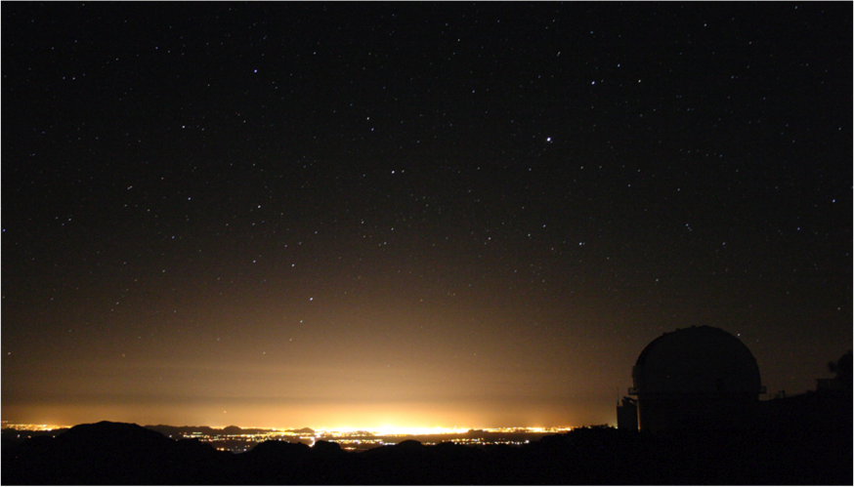
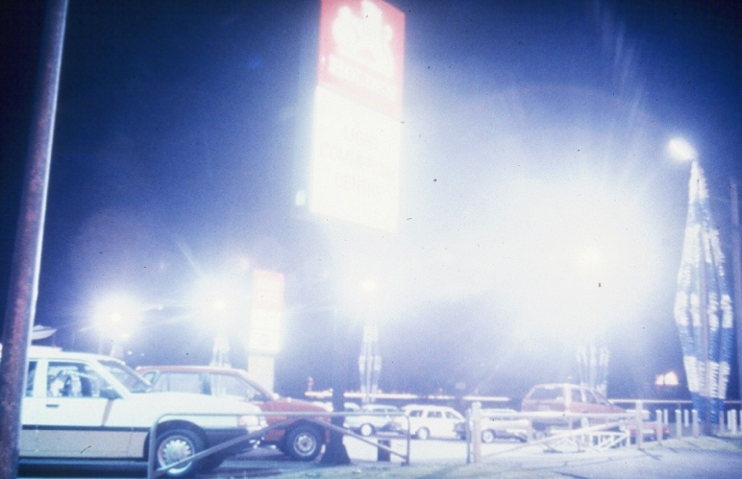
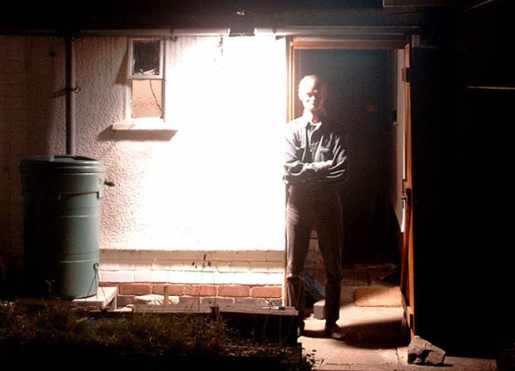
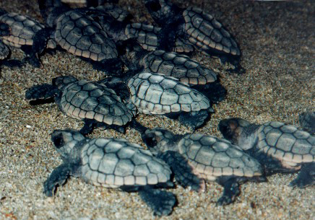
Energy, Safety & Cost
Light Pollution affects…
Astronomical Research
Human Health
Wildlife
Notes:
Light pollution affects more than the ambiance of a night sky:
Safety and security; waste of energy and money; negative affects on habits and habitats of plants and animals
Human health, etc.

Slide 5
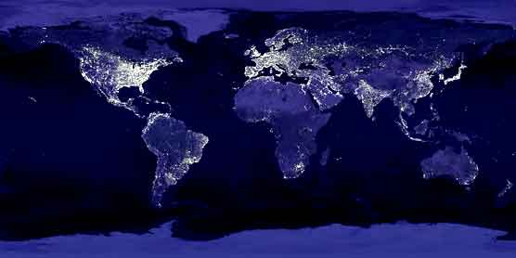
Light pollution is a global issue with local solutions…
Notes:
Light pollution is artificial night sky brightness, directed up toward the sky and wasted. The International Dark-Sky Association estimates that one-third of outdoor lighting escapes unused into space, causing light pollution. Under an unpolluted sky we ought to see 5000 stars, yet we see only a couple hundred from most suburban areas. Two thirds of all US citizens cannot see the Milky Way galaxy from where they live.
------------
2008 marked the first year half of the world’s population lived in cities.
As you can see in this nighttime image of the world, cities are traced by the light pollution they produce.
Here you can imagine the world as ever-growing urban constellations, diminishing our ability to see the stellar constellations.
Is this the heritage we want to leave our children?
The good news is that although light pollution is a global issue, it has local solutions.
The first step is to make people more aware of this global issue and that they can be part of the local solutions.
This is where you as educators come in and can help significantly by providing the education to students.

Slide 6
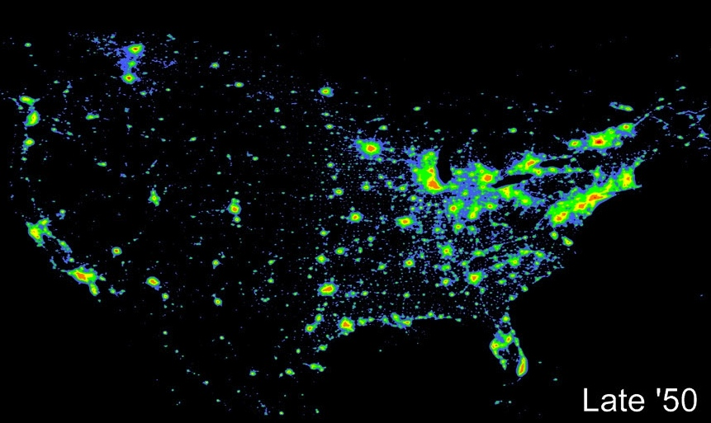
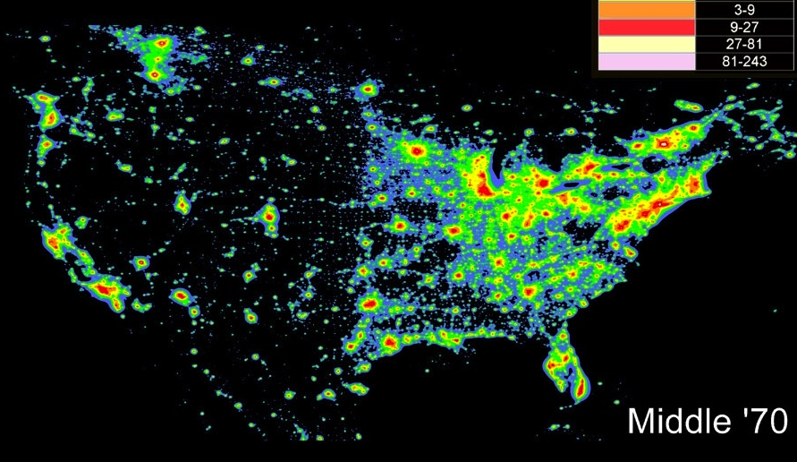
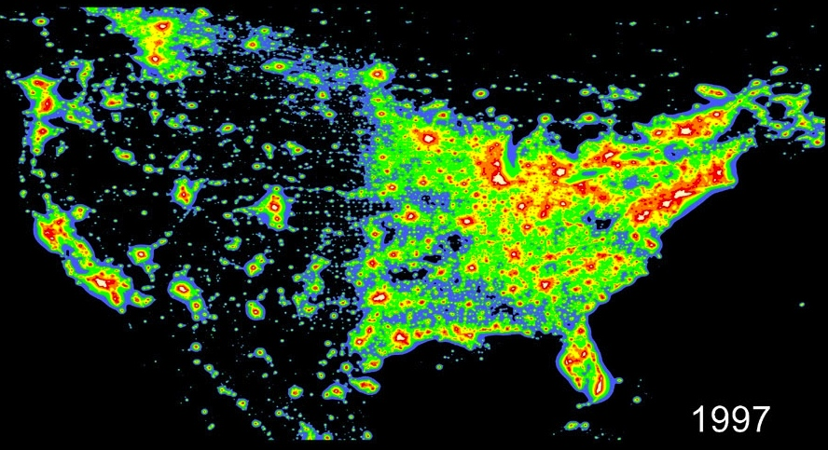
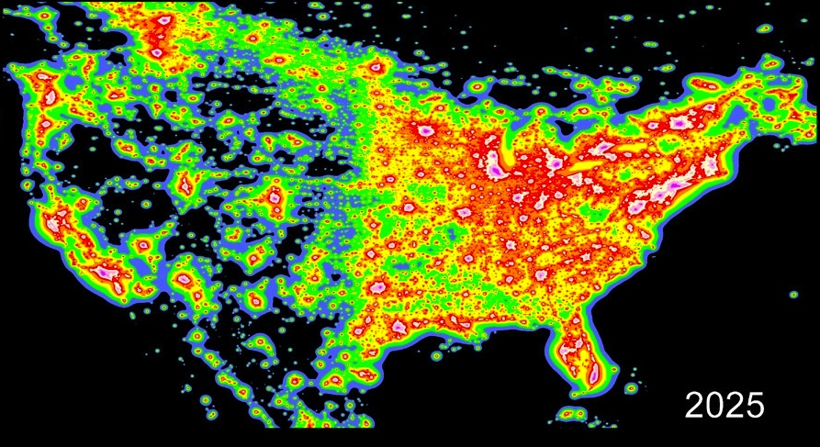
How do you slow down the
increase in light pollution?
(Cinzano, Falchi, and Elvidge 2001)
Notes:
In the US alone, over 2 billion dollars are wasted each year by upward lighting, lighting the undersides of clouds and birds.
Within a Generation the last of our pristine dark skies will probably be gone....

Slide 7
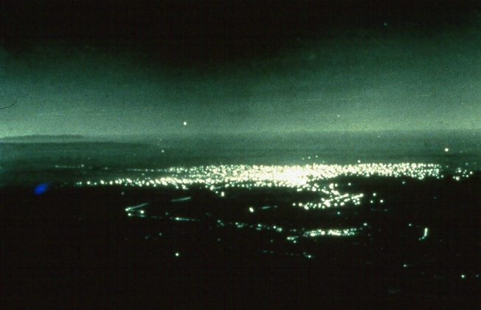
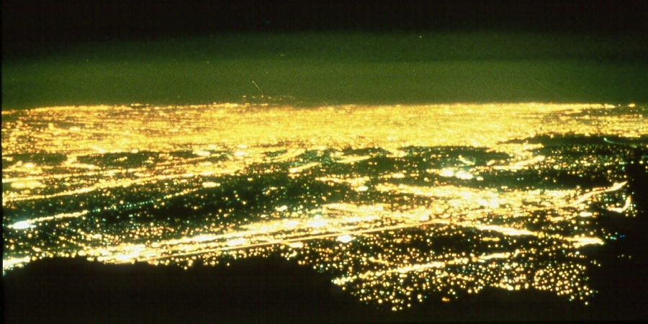
Los Angeles in 1908 & 1988, as seen from Mt. Wilson Observatory
Notes:
7
I didn’t take the one in 1908.

Slide 8
Notes:
LIGHT SHIELDING DEMO DONE HERE.
What if you had have to leave the light on but wanted to direct all the light downwards instead of skywards? (Maximize the amount of light hitting the ground and minimize the amount of light going up) How would you do that?
BEFORE NEXT SLIDE: What were the three main type of light pollution?

Slide 9
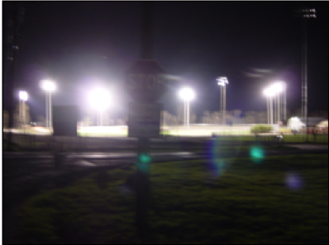
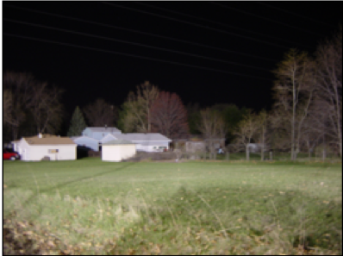
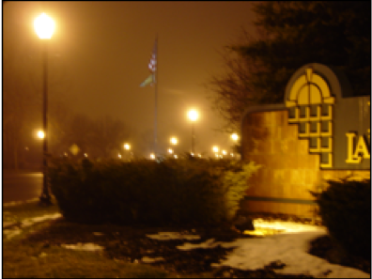
3 Types of Light Pollution
Glare
  Too much background light
  Reduces visibility
Light Trespass
  Light spills into an area where it is unneeded and/or unwanted
Sky Glow
  Upward directed light reflects off of particles in the sky reducing visibility of stars
Notes:
BEFORE NEXT SLIDE: How can you minimize the effects of these types of light pollution?

Slide 10
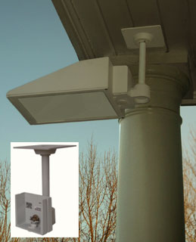
By Using Shielded Fixtures
You…
Shine the light down.
See the effect, not the source.
Light only where and when needed.
Don’t over light.
Use energy efficient sources.
And therefore…
Minimize: glare, light directed upward, energy use & cost
Maximize: safety and your ability to enjoy the stars.

Slide 11
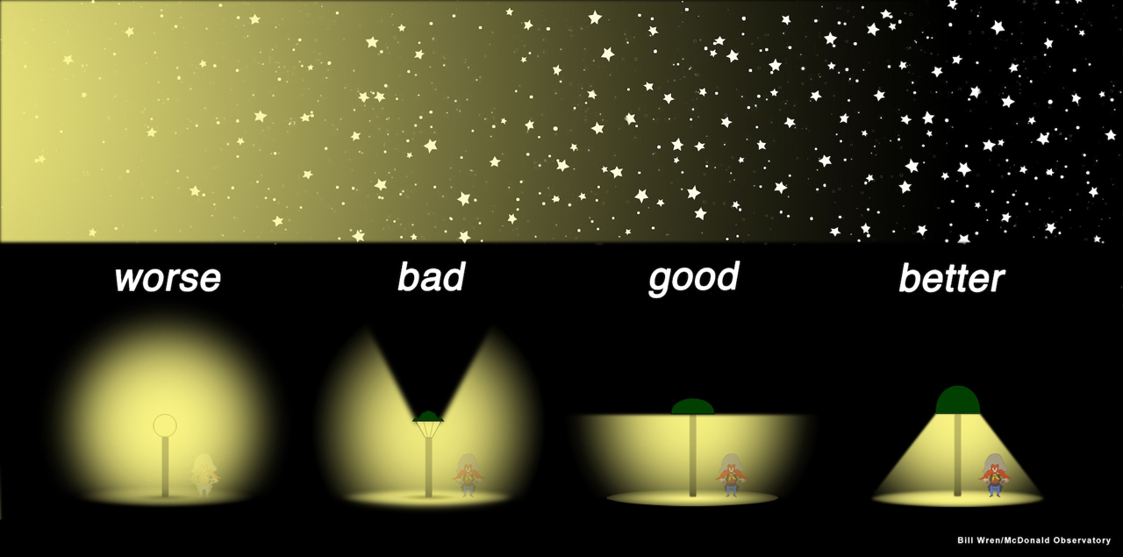
Examples of Good & Bad Lighting and How Many Stars You Can See
11
Notes:
And here we are (with the fixture on the right), enjoying the stars by fully shielding the light, so you do not see the source, but only the effect (its footprint).

Slide 12
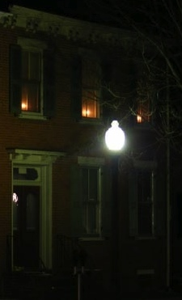
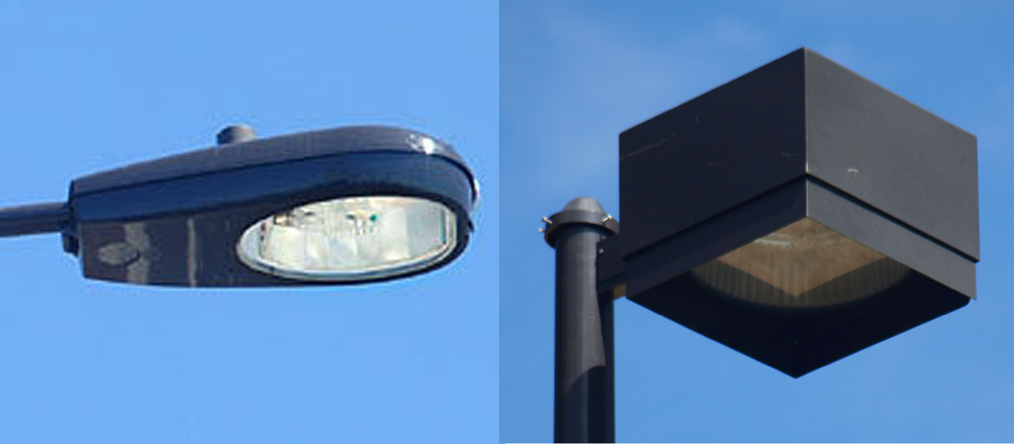
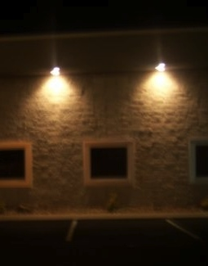
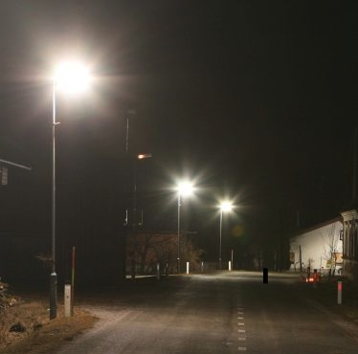

12
Notes:
Which are good examples and not-so-good examples of light fixtures?

Slide 13
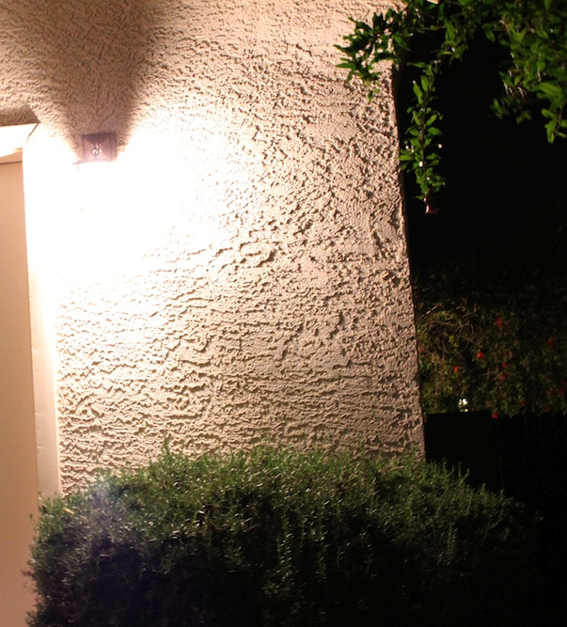
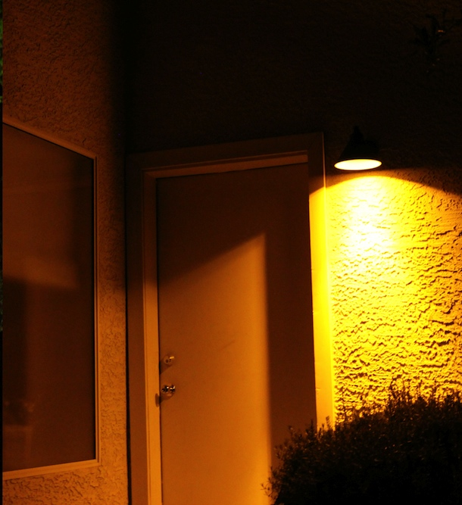
Before and After

Slide 14
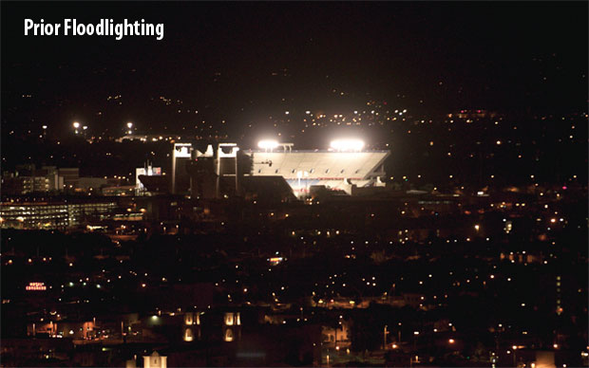
Credit: Monrad Engineering, Inc. & Musco Lighting

Slide 15
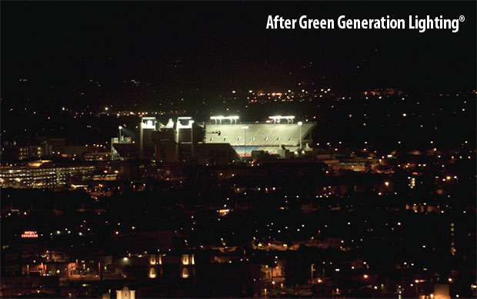
Credit: Monrad Engineering, Inc. & Musco Lighting

Slide 16
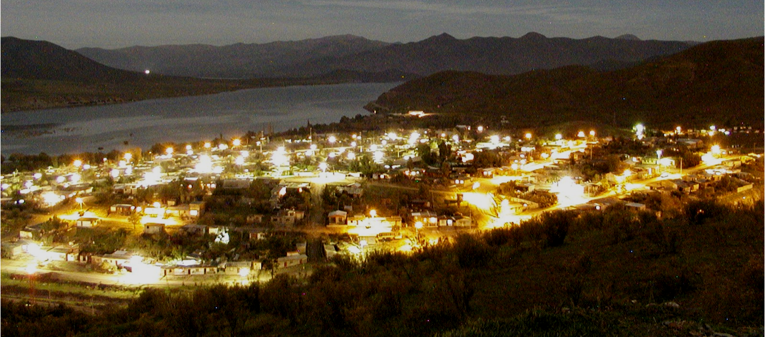
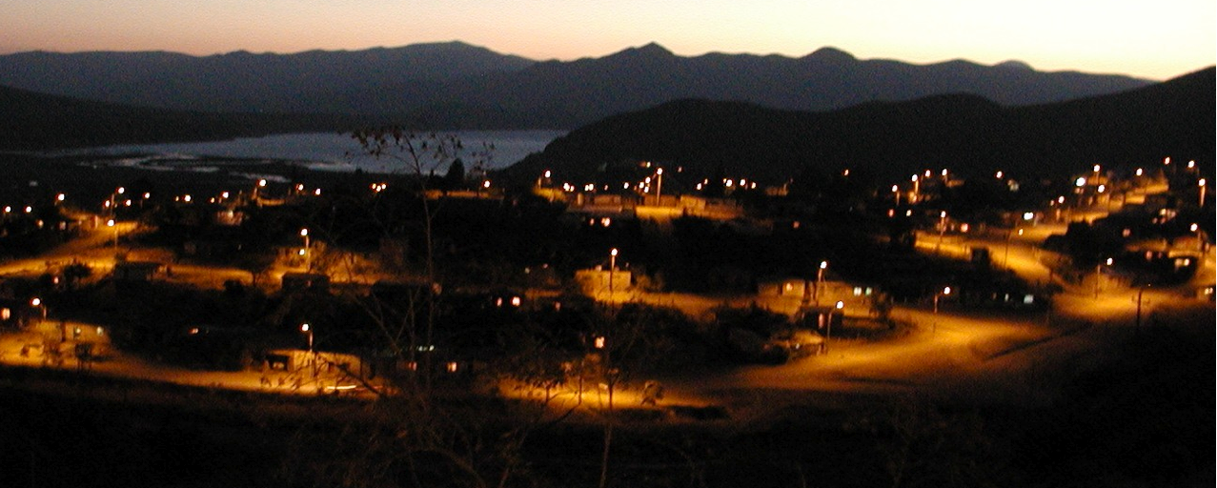
An Example of
Bad & Good Lighting
Notes:
Monte Patria, Chile before and after retrofitting lights

Slide 17
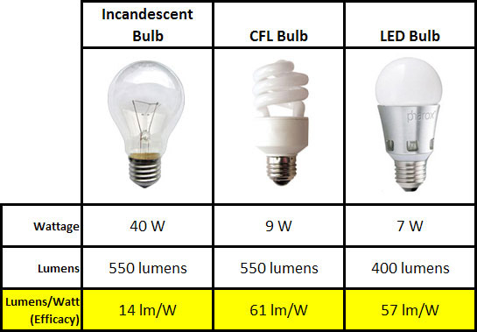

Slide 18
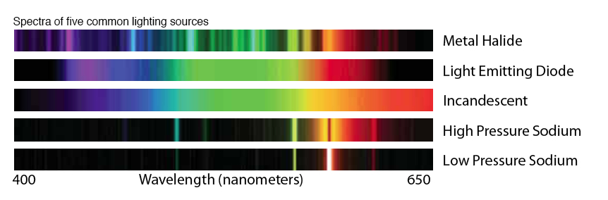
Light Sources

Slide 19
Activities
Demonstration of Light Pollution & Shielding
Spectra of Lights
Outdoor Lighting Audit
Constellation at Your Fingertips
Magnitude Reader
The Night You Hatched

Slide 20
GLOBE at Night http://www.globeatnight.org
Notes:
One way we are trying to bring more awareness to the public on issues surrounding light pollution….

Slide 21
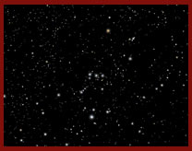
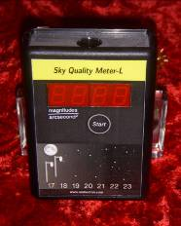
GLOBE at Night http://www.globeatnight.org
Citizen-scientists record the brightness of the night sky by visually matching the appearance of a constellation like Orion with star maps of progressively fainter stars or using meters to obtain more precise measurements.
Measurements are reported on-line and resulting maps of all worldwide observations are created.
Over the last 8 years of 10-day GLOBE at Night campaigns, close to 100,000 measurements have been contributed from over 115 countries.
Notes:
BEFORE NEXT SLIDE: How would you visually determine how bright a night sky is using stars?
What is meant by a limiting stellar magnitude?

Slide 22
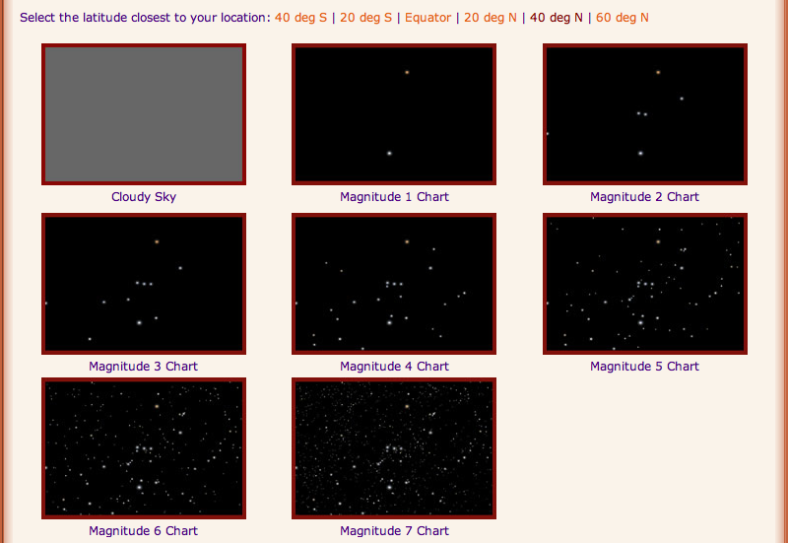
No Orion data
Match Night Sky to a Magnitude Chart.
Estimate cloud coverage.
Input location, date & time.

Slide 23
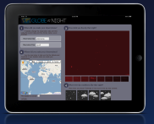
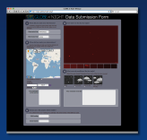

Simple Report Form
Cell
Phone
Tablet/Pad
Desktop/
Laptop
Measurements
are downloadable as datasets in various formats
can be examined online via Google Earth or other tools
used as the basis of research in a classroom or science fair project or even to inform the development of public policy
Notes:
You can see the map app at http:/www.globeatnight.org/mapapp/.

Slide 24
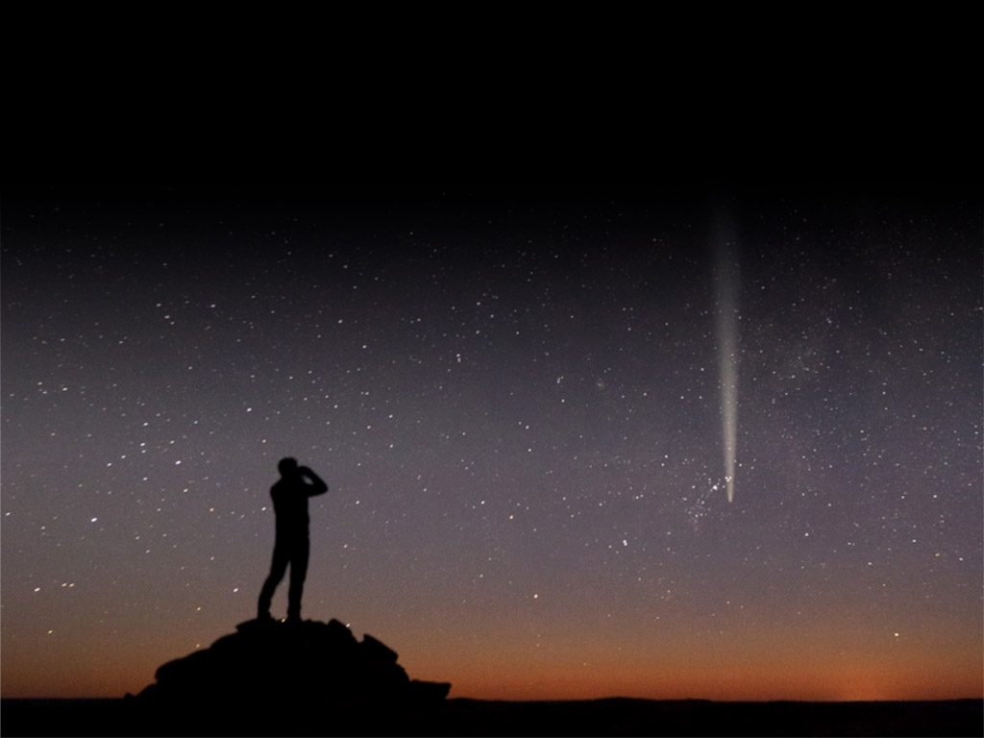
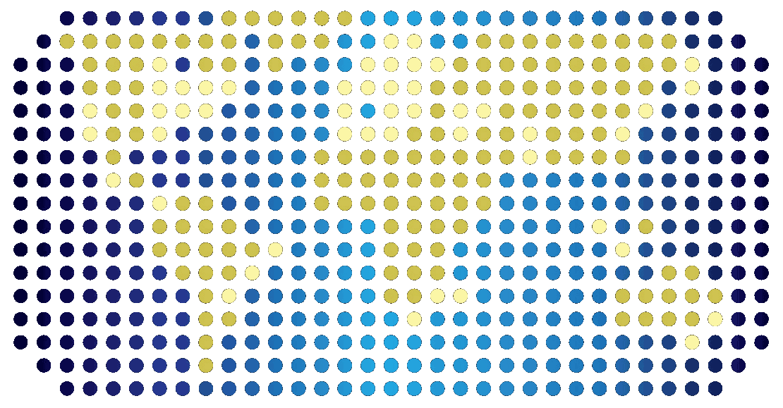
GLOBE at NIGHT
Citizen Science Campaign
To Measure Night Sky Brightness
2014 campaign dates:
^{January 20 - 29, 2014}
^{February 19 - 28, 2014}
^{March 21 - 30, 2014}
^{April 20 - 29, 2014}
^{May 19 - 28, 2014}
globeatnight.org

Slide 25
GLOBE at Night data from Tucson
To collect lots of GLOBE at Night data more efficiently, Tucson participates in “Adopting a Street”.

Slide 26
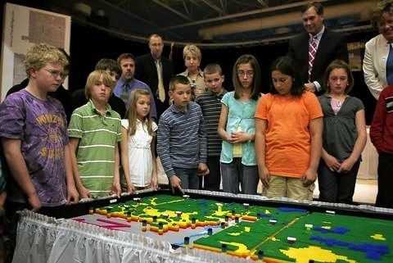
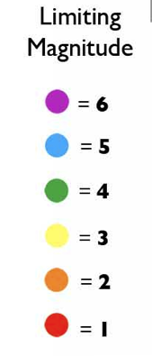
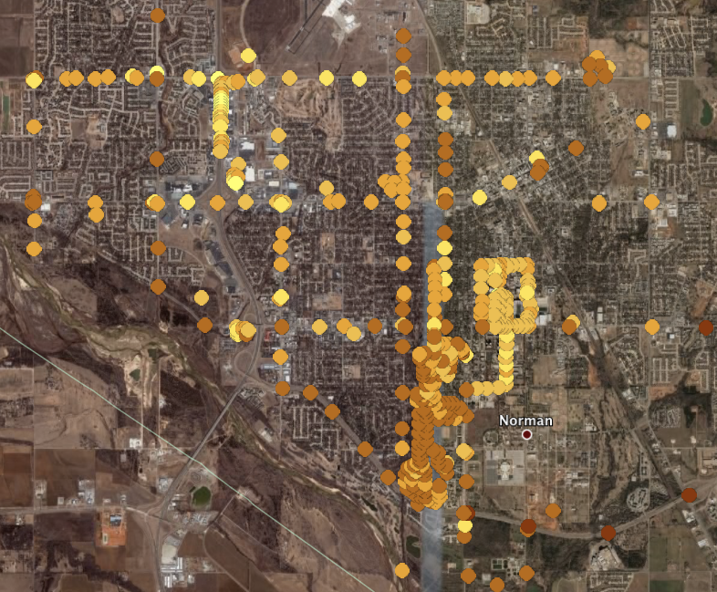
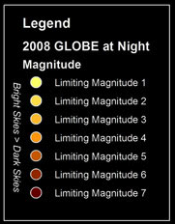
Projects Done by Students
High school students with amateur astronomers from Norman, Oklahoma
Elementary & middle school students near South Bend, IN
Notes:
Projects done by students with GLOBE at Night data.
Elementary and middle school students visualized their GLOBE at Night data by building a 35,000 piece lego map and then taking away 12,000 to represent the map of results.
High school students with amateur astronomers take GLOBE at Night visual and SQM measurements of the streets, business areas and University (eg, stadium). Map was used to convince city officials that stricter lighting codes were needed in the city.

Slide 27
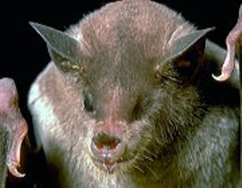
Research Experiences
for Undergraduates Program
Behavior of light pollution over time in and around Tucson
Preference of Lesser Long Nosed bats to avoid Tucson city center
Tucson
Notes:
REU students use GLOBE at Night data on their topic of research.

Slide 28
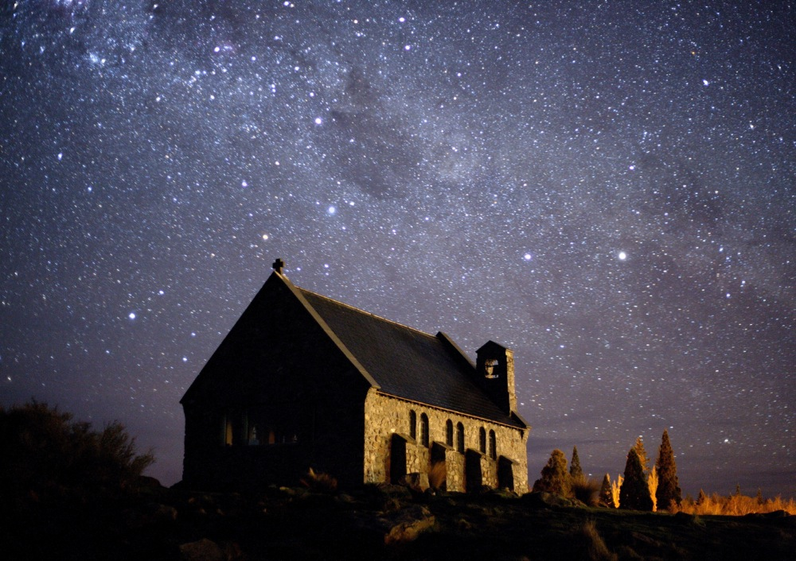
CONTACT INFORMATION
Connie Walker
National Optical Astronomy Observatory
cwalker@noao.edu
520-318-8535

